Slide 1
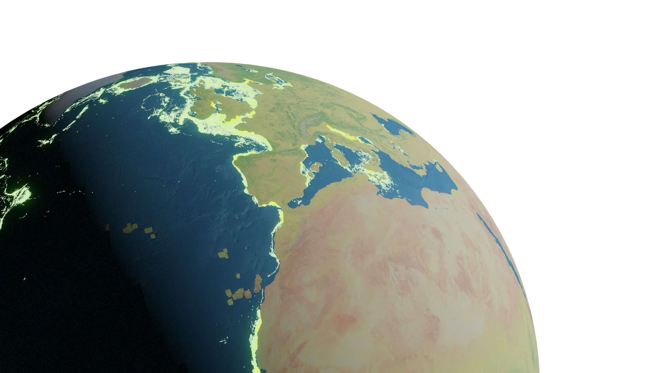
GFW Raster processing

Slide 2
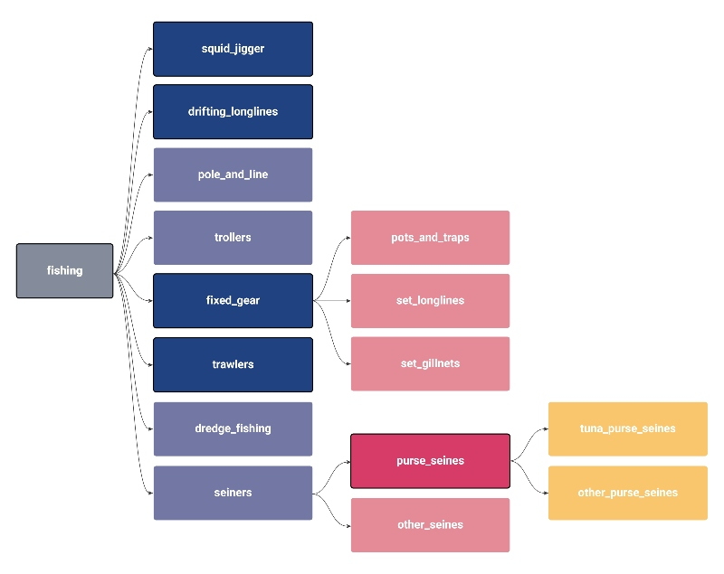
Global Fishing Watch (GFW) data
Open Access fisheries data from all the globe (fishing hours)
2012-2020
Different fishing gears
Other data: Flag,hours,mmsi present
Monthly/daily data
Standarization (GFW v2)
Database has its limitations
GFW (2021)

Slide 3
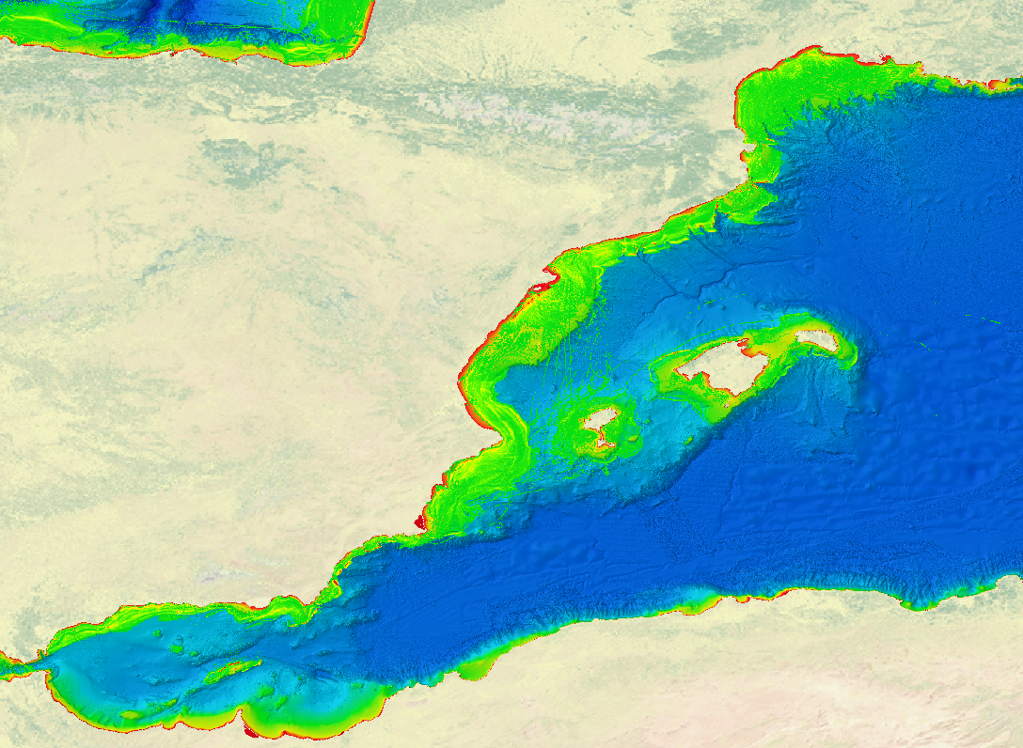
Aim
Update data ( 2017 standarization)
Rasters of a month/year (sum of values) from daily data
Multiple databases (gears,time periods…)

Slide 4
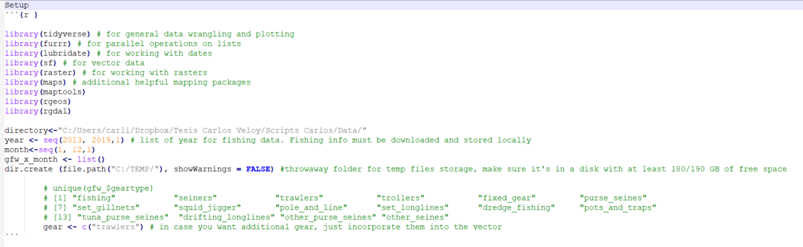
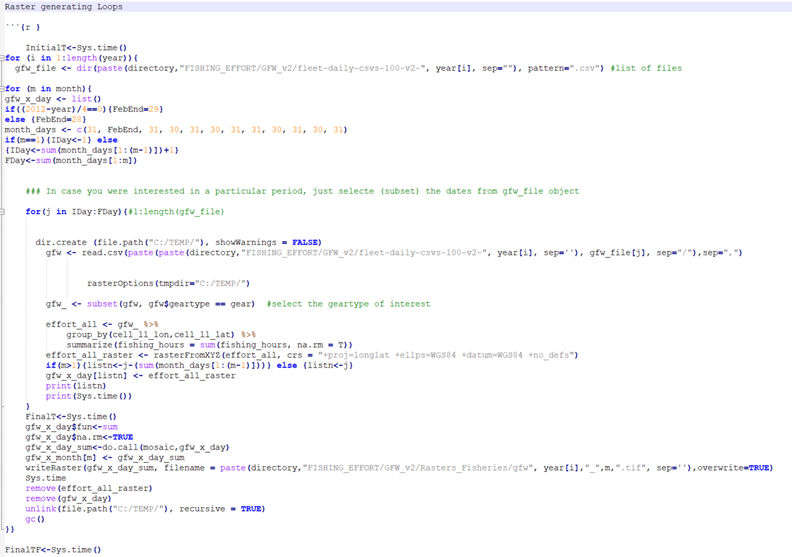
Script I: Monthly data
Initialization of objects and labels
1- Filter dataframe and create daily rasters
2- Sum all the daily rasters (mosaic)
Workspace cleanup
Output: 12 month rasters (gfw[year]_[month].tif)

Slide 5
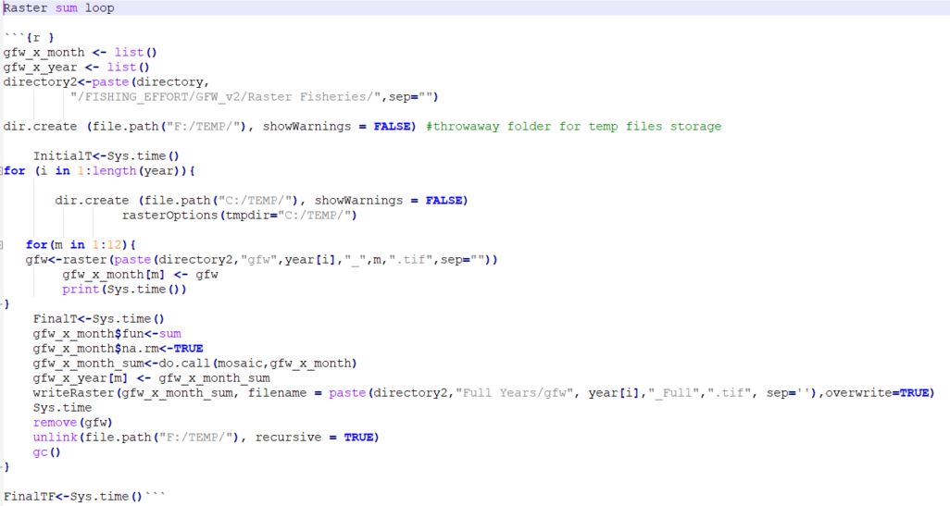
Script II: Yearly data
Initialization of objects and labels
Sum all the monthly rasters (mosaic)
Workspace cleanup
Output: 7 year (2013-2019) rasters (gfw[year]_Full.tif)

Slide 6
Other notes
Specs:
Requirements : HDD/SDD space
~50 GB (gfw yearly data)
~70 GB (temporal files)
~2 GB (final rasters)
Recommended : >30GB RAM, Intel i7 >9th generation
Duration of a month loop*: Approximately 30 min
Duration of a year loop*: Approximately 7 hours
*Selecting only trawlers

Slide 7


Resources
Code:
Dropbox folder
Github repository
Data and rasters:

